Slide 1
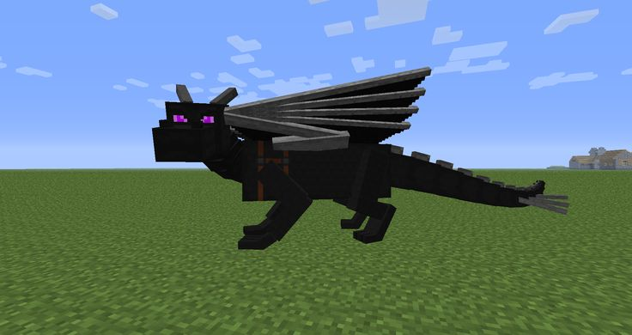

Team “ender dragon”
HTML5/CSS3 web project
By:
Христо Петров
Анастасия Вълчева
Илиян Илиев
Димитър Велков

Slide 2
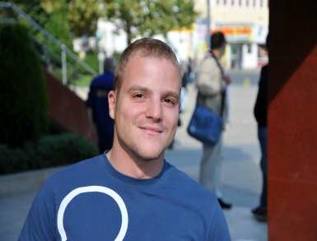

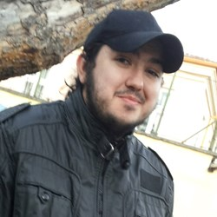

Team members
Христо Петров
Code Monkey
Image content
Site design
Анастасия Вълчева
Code Monkey
Image content
Site design
Илиян Илиев
Main content
Site design
Project idea
Димитър Велков
Main content
Code Monkey
Site design

Slide 3
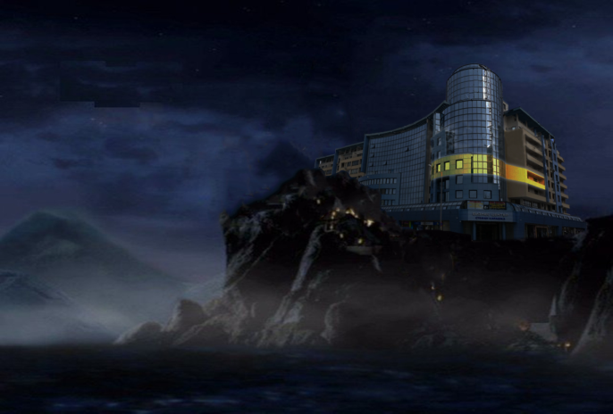
Project task
Create a funny web site about Software University.
Team “Ender Dragon” project name:
“Softwards University”
hpetrovit.com/webproject/softuni-teamproject/

Slide 4

Web site preview

Slide 5
result
Simple design
Funny content
Easy to read and navigate
Looks great on mobile as on desktop
HTML5 and CSS3 valid!

Slide 6
Tools and resources
Languages: HTML5, CSS3, Javascript
IDEs: Visual Studio, WebStorm
Libraries: JQuery
Version control tool: GitHub
Web: Google

Slide 7
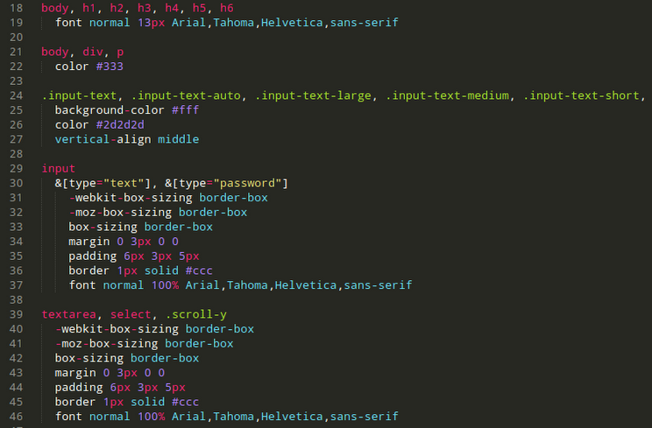
Source preview

Slide 8
Thanks for your attention

